Slide 1

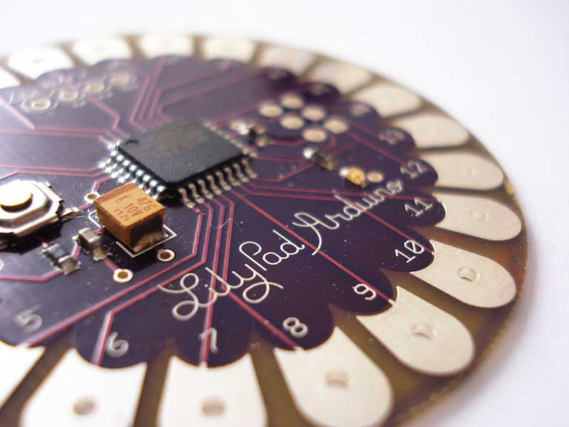
Implementation of microcontrollers into the Colorado Fashion Design and Merchandising Curriculum: An Exploratory Case Study
Educational Technology Leadership
Dr. Katrina Blatnick-Gagné

Slide 2
Statement Problem and Purpose

Slide 3
Statement of the Problem
There have been many research studies that have been completed at post-secondary institutions, by professional organizations, and by business and industry that discuss the integration of technology into classrooms and schools (Cubero, 2015; Stager, 2007; Buechley, 2007; Buechley & Eisenberg, 2008).
Research on how to integrate technology, such as the microcontroller, into elective courses such as FCS Fashion Design and Merchandising was almost non-existent.

Slide 4
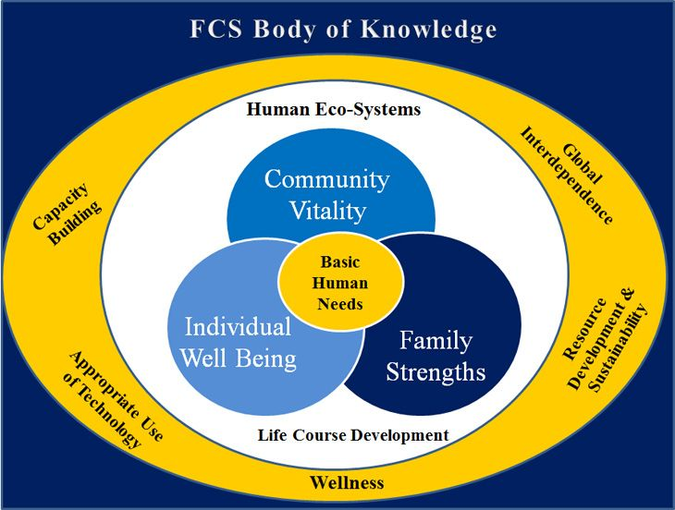
FCS BODY OF KNOWLEDGE
In its latest revision in 2003, the body of knowledge, which is referred to as the intellectual foundation of the field of family and consumer sciences, includes five cross-cutting themes.
Appropriate use of technology is one of the five cross-cutting themes.
I believe that technology will have the greatest impact on FCS curriculum now and in the future.
  Microcontrollers in FCS FDM is a natural fit

Slide 5
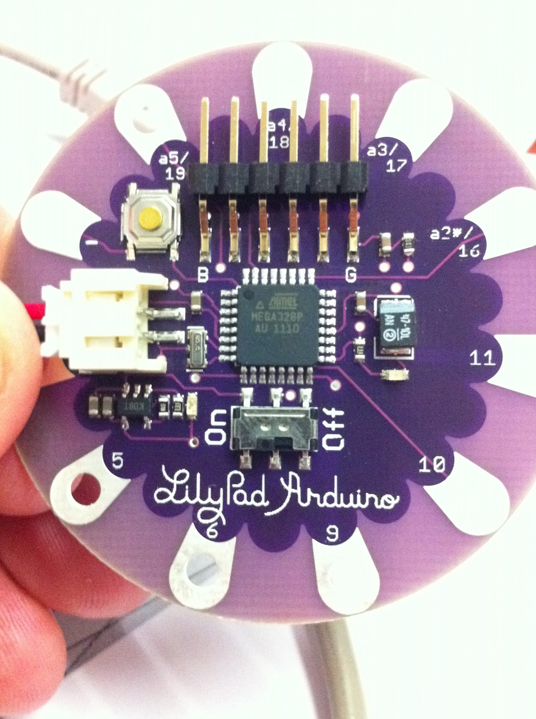

Purpose of the Study
There is a need for “ambient intelligence” where intelligent devises are integrated in everyday surroundings, smart clothing is a perfect place for this intelligence because it can be personalized, embedded, unobtrusive, and used anytime and anywhere (Cho, Lee, Cho, 2009).
Research how the LilyPad Arduino can be implemented into the state-wide curriculum based on the data collected during the research phase which focused on teacher input, administrator viewpoints, and available resources.

Slide 6
Research Questions

Slide 7
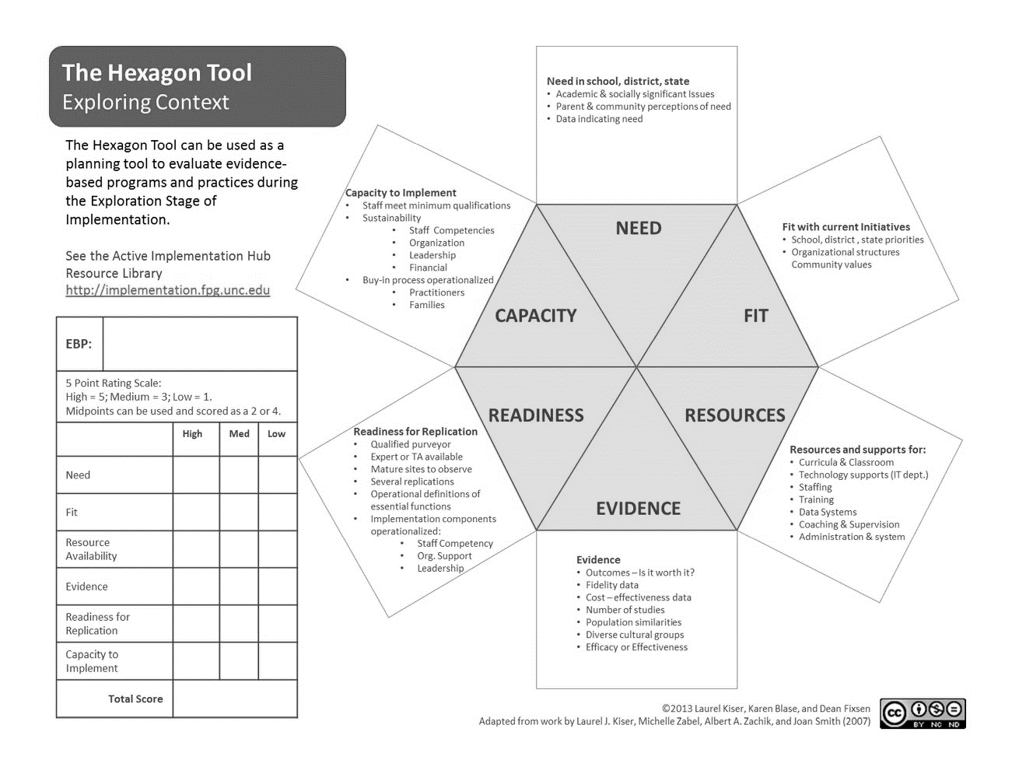
The Hexagon Tool
Created through implementation research (Kiser, Zabel and Smith, 2007) as a tool that can help states, districts and schools evaluate new and existing interventions using six broad factors (Blase, Kiser, Van Dyke, 2013).
Used as a foundation for creating the research questions.
The Hexagon Tool. From “The Hexagon Tool: Exploring Context,” by K. Blase, L. Kiser, and M. Van Dyke, 2013, National Implementation Research Network, FPG Child Development Institute, University of North Carolina at Chapel Hill. Copyright 2013 by K. Blase, L. Kiser, and M. Van Dyke. Used with permission.

Slide 8
Research Questions
Central Question
  How can Colorado Family and Consumer Sciences Fashion Design and Merchandising teachers successfully implement of the use of microcontrollers into the state-wide curriculum?
Sub Questions
  What resources are needed to successfully implement the use of microcontrollers into the Colorado Family and Consumer Sciences Fashion Design and Merchandising course?
  What is the capacity to implement the use of microcontrollers into the Colorado Family and Consumer Sciences Fashion Design and Merchandising course?
  When the use of microcontrollers is implemented in a Fashion Design and Merchandising class, what evidence outcomes might be expected if the practice is implemented well?

Slide 9
Theoretical Framework

Slide 10

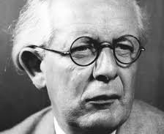
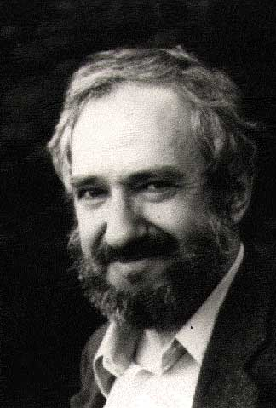
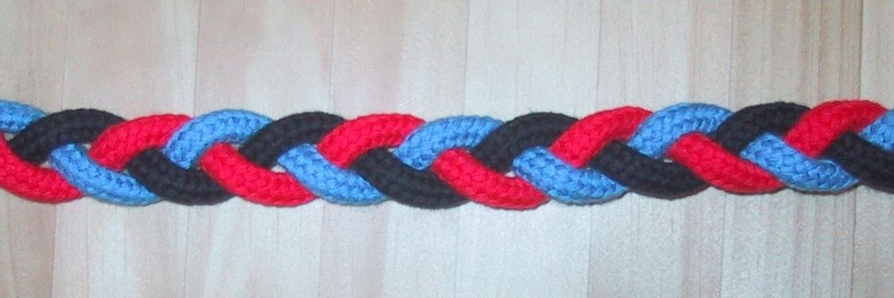
Theoretical Frameworks
Weaving three theoretical frameworks together, like a braid, provided a strong foundation for this research
  Piaget’s Constructivism
  Papert’s Constructionism
  Personal Epistemology

Slide 11
Constructivism
Piaget (1896-1980)
People produce knowledge & form meaning from their learning experiences.
Fours stages of cognitive development.
Learning should be an active hands-on experience, allowing for trial and error.
Piaget is responsible for generally influencing much of the research in personal epistemology (Bendixen and Feucht, 2000).
Constructionism
Papert (1928-2016)
Builds upon Piaget’s cognitive development partnering with cutting-edge technological advances.
Both a theory of learning and a strategy for education that offers the framework for developing a technology-rich, design-based learning environment (Bers, 2008).
Encourages the development of “powerful ideas”.
Personal Epistemology
Perry (1970, 1981) describes epistemology as personal beliefs about what knowledge is, how it can be gained, limits (Brownlee, 2004).
Bendixen and Feucht (2000) stated, “personal epistemology impact argumentation, problem-solving and achievement (p. 4).
Research indicates evidence that personal epistemology plays a crucial role in one’s knowledge attainment (Hofer, 2001).

Slide 12
Literature Review

Slide 13
Literature review
Through the decades, home economics has played an important role. (Gentzler, 2012).
There are parallels between clothing and textiles fields within FCS and STEM. FCS also allows for project-based, real-world learning (Carter, Beachner & Daugherty 2015).
Opportunities exist to integrate computer science, engineering, textile, and fashion design to create e-textiles appeal to a broad audience and create a platform for PBL and powerful ideas (Buechley & Eisenberg, 2008).
Taking risks, testing boundaries, experimenting, and tinkering are all aspects of play that contribute to a student’s rich learning environment (Papademetri-Kachrimani, 2015).
Meaningful change within organizations begins with the exploration stage of implementation (Fixsen, Ward & Sims, 2014).
Following a constructionism framework, Papert (2000) and Papademetri-Kachrimani (2015) demonstrated how creating opportunities for big ideas and powerful ideas allow students deeper connections to knowledge attainment.
Notes:
In today’s classrooms, there is a mix of instructional theories that teach students applied skills, skills for gainful employment, and skills that hold true to Brown and Paolucci’s belief that home economics education should be a way for students to evaluate their society and determine better ways of living, reaching beyond skill boundaries and encourage people to think, create, and act in the best interest of the world

Slide 14
Method

Slide 15
Qualitative Case Study
Qualitative research studies foreshadow problems and explore the meaning of individuals or groups in a specific context (Gay et al. 2012).
Qualitative research involves emerging questions and procedures: data are typically collected in the participants’ setting, data analysis is derived from general or particular themes, and the researcher makes interpretations in regard to those themes. (Creswell, 2014).
The goal of such research, according to Creswell (2014), is to rely as much as possible on the participants’ views of the situation being studied.

Slide 16
Qualitative Case Study
Case study research is unique in that it leads to a different kind of knowledge compared to other types of research, and they provide intensive descriptions and analyses of a single unit or bounded system.
This study was both particularistic, focusing on a program or phenomenon, and heuristic, meaning the case study can bring about the discovery of new meaning and extend that to the reader’s experiences or confirm what is known (Merriam, 1998).

Slide 17
Participant Description

Slide 18
Participant | Number of Years Teaching FDM | Type of School | Interest in Participation | Willing to Integrate Tech | Knowledge of Microcontrollers
Teacher 1 | 15 | CTE Center | I held a workshop 2 years ago about STEM in FDM, looking to advance knowledge. | Yes, has experience with STEM | Yes
Teacher 2 | 9, CO & other States | Comprehensive High School, Denver Metro Area | This is a good way to incorporate tech and get kids thinking outside the box. | Yes | Yes, only through workshops
Teacher 3 | 12 | Comprehensive High School, Denver Metro Area | I want to learn about new technology used in the fashion industry. | Yes | No. Used LilyPad coin-cell battery packs with LED Lights
Teacher 4 | 3 | Comprehensive High School, Denver Metro Area | I love fashion design and am always looking for new ideas to use in my classroom. | Yes, masters is in Technology | No
Teacher 5 | 10 | Comprehensive High School, Denver Metro Area | I’m interested in learning how to use the LilyPad in hopes of possibly integrating the technology into FDM. | No | Very little
Teacher 6 | 5 | Comprehensive High School, Denver Metro Area | I want to learn more because I don’t know what they are. | Yes, 4 out of 5 in comfort level | No
Program Director | 11 | State | I feel its important to continuously learn and update skills to be more effective in the classroom. | Yes- statewide initiative | Very little

Slide 19
Data collection

Slide 20
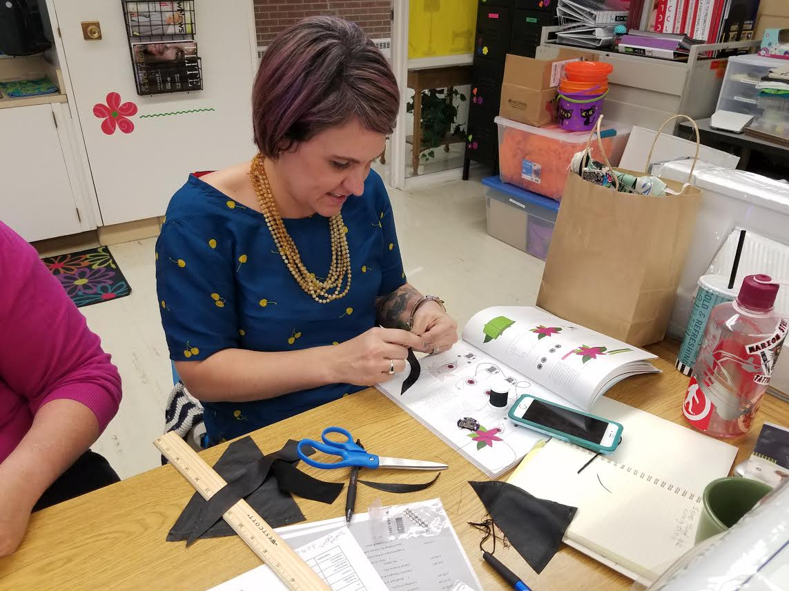
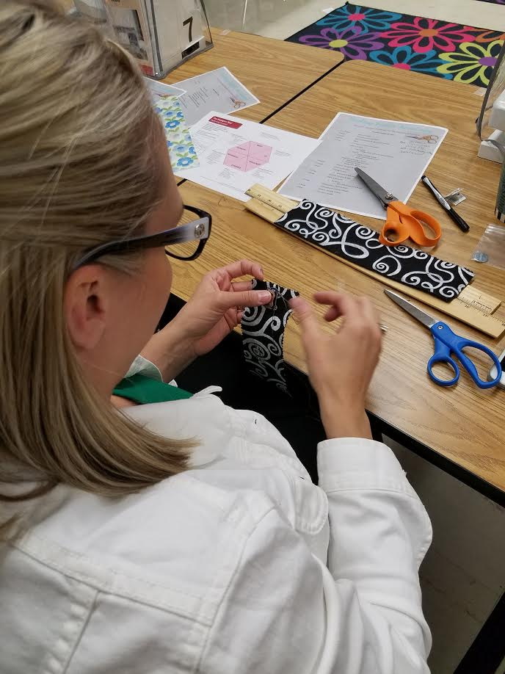
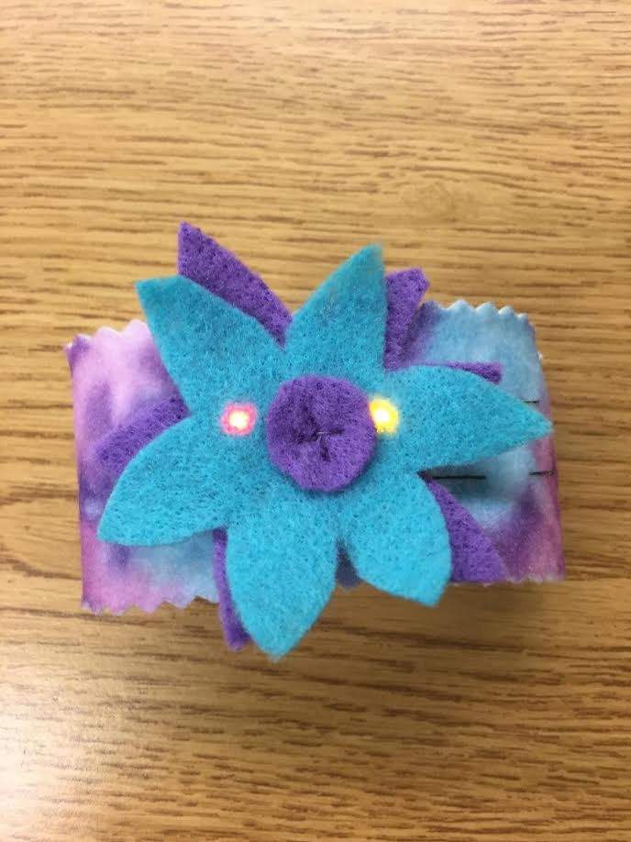
Data Collection
Four Phases
  Phase 1: Teacher Participant Recruitment
    Interest Survey
  Phase 2: Professional Development
    Two-day Coding Fabric Academy workshop
    Debrief Session
    Post Survey

Slide 21
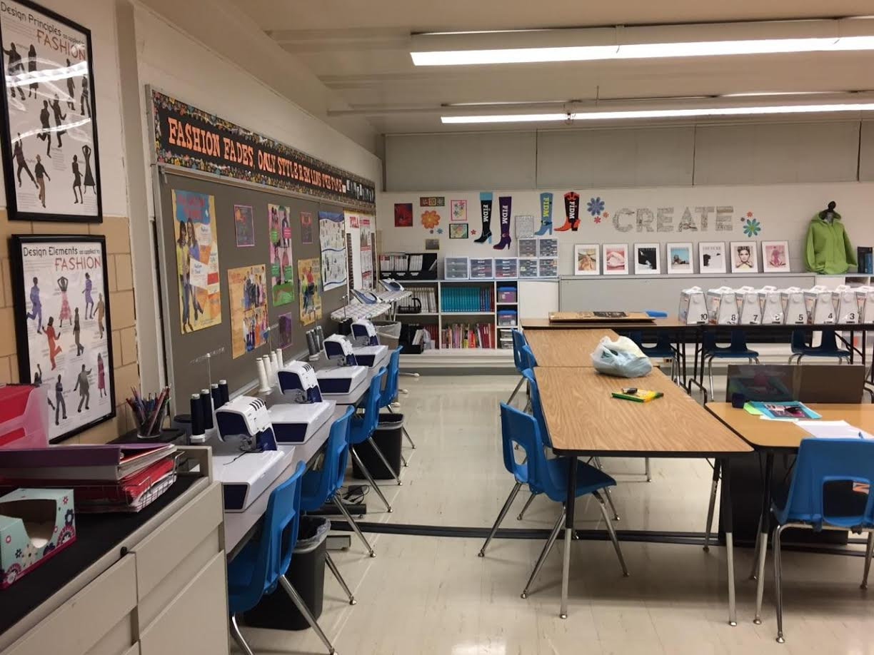
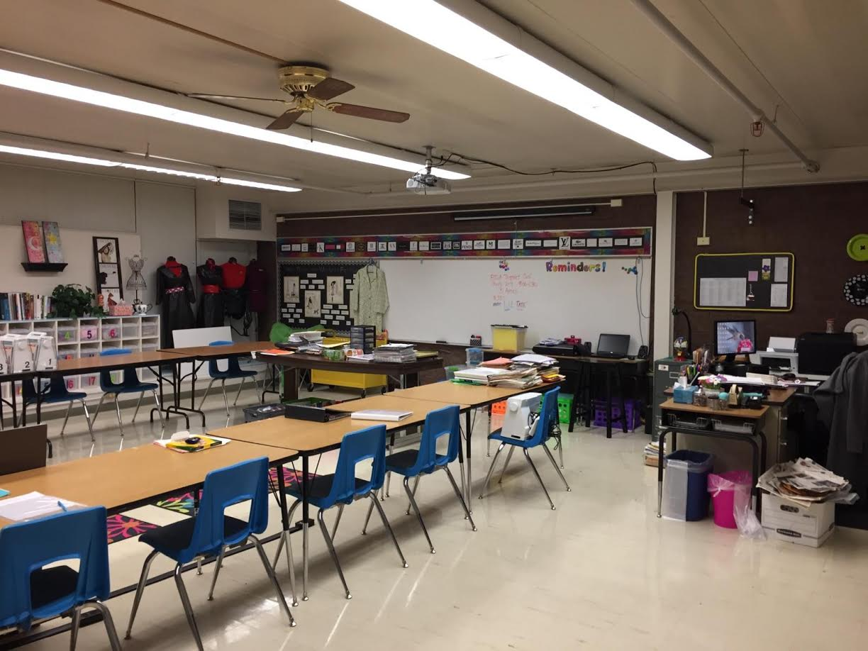
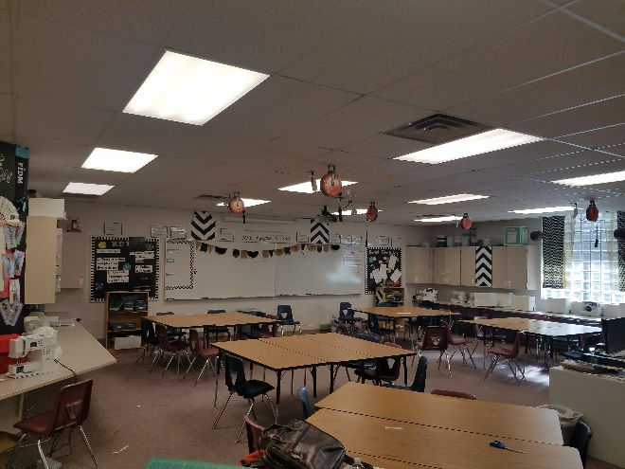
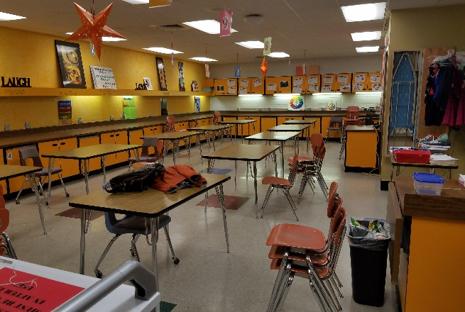
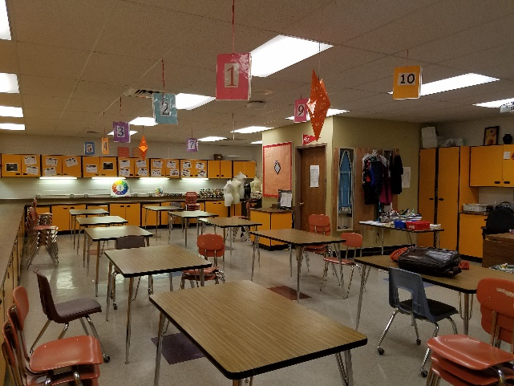
Data collection, continued…
  Phase 3: Phone Interviews
    Guided questions & probing/clarifying questions (derived from Phase 2 survey)
  Phase 4: Site Visits and Interviews
    Three site visits
    In-person interviews with FCS Teachers
    In-Person Interviews with the Administrator over the FDM program
    Classroom Observations

Slide 22
results

Slide 23
Emergent Themes
Themes aligned with the three broad factors of the Hexagon Tool
  Theme 1: Resources
    Funding
    Professional Development
    Technology Support

Slide 24
Emergent Themes, continued…
  Theme 2: Capacity
    Personal Teaching Beliefs (Personal Epistemology)
    Professional Development

Slide 25
Emergent Themes, continued…
  Theme 3: Evidence Outcomes
    Unit of Study
    Intra and Cross-Curricular Connections

Slide 26
Recommendations

Slide 27
Recommendation 1
Provide Professional Development
  Access to PD will be a key factor
  May pique the interest of teachers
  CO FCS Program Director must take a lead in providing PD
  Hold workshops at the annual CATFACS Conference
  Introductory workshops, similar to the two-day Coding Fabric Academy should be offered yearly, with advanced workshops as needed

Slide 28
Recommendation 2
Lesson Plans, Assessments and a Resources Library
  Have an Implementation Team work with the CO FCS Program Director to
    Create a Unit of Study that includes
      Lesson Plans, Activities, Assessments and Rubrics
    Develop a Resource Library that could be accessed by teachers and students
    Make FCS Standards connections, crosswalk to CO Academic Standards and demonstrate STEM connections
    Develop a FCCLA State-level Competitive Event

Slide 29
Recommendations for future research
Extend this study, or use as a basic foundation to study the actual implementation of microcontrollers in the classroom
Use the Hexagon Tool to look at the other three broad factors– Evidence, Fit, and Need
Use an instructional design model to help guide the development of a curriculum in regards to the implementation of microcontrollers
  ADDIE
    Analysis, Design, Development, Implementation and Evaluation

Slide 30
Conclusion

Slide 31
Conclusion
Colorado FCS teachers can successfully implement the use of microcontrollers into the state-wide curriculum by having access to resources such as funding, professional development, and technology support.
FCS teacher’s personal teaching beliefs (personal epistemology) will have an impact on their capacity to implement microcontroller technology.
The Colorado FCS FDM curriculum can be enhanced by the addition of microcontroller technology.
It is now up to individual teachers and the Colorado FCS Program Director to begin the implementation process.

Slide 32
Contact Information
Katy Blatnick-Gagné
Katy.blatnick-gagne@ttu.edu
www.stellerevo.com (Doctoral Portfolio)
www.codingfabricacademy.com

Slide 33
References
Bendixen, L., & Feucht, F. (2010). Personal epistemology in the classroom: Theory, research, and implications for practice. New York, NY: Cambridge University Press.
Bers, M. U. (2008). Blocks to robots: Learning with technology in the early childhood classroom. New York, NY: Teachers College Press.
Blase, K., Kiser, L., & Van Dyke, M. (2013). The hexagon tool: Exploring context. University of North Carolina at Chapel Hill, National Implementation Research Network, FPG Child Development Institute.
Brownlee, J. (2004). Teacher education students' epistemological beliefs. Research in Education, 72(1), 1-17.
Buechley, L. A. (2007). An investigation of computational textiles with applications to education and design (Doctoral dissertation). Retrieved from ProQuest Dissertations & Theses Global. (Order No. 3284406): https://search.proquest.com/docview/304859237?accountid=12793
Buechley, L., & Eisenberg, M. (2008). The LilyPad Arduino: Toward wearable engineering for everyone. IEEE Pervasive Computing, 7(2). Retrieved from http://ieeexplore.ieee.org/abstract/document/4487082/?reload=true
Carter, V., Beachner, M., & Daugherty, M. (2015). Family and consumer sciences and STEM integration. Journal of Family and Consumer Sciences, 107(1), 55–58.
Cho, G., Lee, S., & Cho, J. (2009). Review and reappraisal of smart clothing. International Journal of Human-Computer Interaction, 25(6), 582–617. doi:10.1080/10447310902997744
Creswell, J. W. (2014). Research design: Qualitative, quantitative, and mixed methods approaches (4th ed.). Los Angeles, CA: Sage.
Cubero, S. N. (2015). A fun and effective self-learning approach to teaching microcontrollers and mobile robotics. International Journal of Electrical Engineering Education. doi:10.1177/0020720915585798
Fixsen, D., Ward, C., & Sims, B. (2014). Scaling-up brief: Exploration stage. State Implementation & Scaling-Up of Evidence-Based Practices Center, (4), 1–5.
Gay, L. R., Mills, G., & Airasian, P. (2012). Educational research: Competencies for analysis and applications (10th ed.). Upper Saddle River, NJ: Pearson.
Gentzler, Y. (2012, Summer). Home economics: Ever timely and forever complex. Phi Kappa Phi Forum, 92(2), 4–7.
Goldberg, M. F. (1991). Portrait of Seymour Papert. Educational Leadership, 48(7), 68–70.
Hofer, B. K. (2001). Personal epistemology research: Implications for learning and teaching. Educational Psychology Review, 13(4), 353–383.
Merriam, S. B. (1998). Qualitative research and case study applications in education: Revised and expanded from case study research in education. San Francisco, CA: Jossey-Bass.
Papademetri-Kachrimani, C. (2015). Learning about learning with teachers and (from) young children. Constructivist Foundations, 10(3), 370–381.
Papert, S. (1993). Mindstorms: Children, computers, and powerful ideas (2nd ed.). New York, NY: Basic Books.
Papert, S. (2000). What's the big idea? Toward a pedagogy of idea power. IBM Systems Journal, 39(3), 720.
Stager, G. (2007). Towards the construction of a language for describing the learning potential of computing activities. Informatics in Education, 6(2), 429–442.

